Slide 1
TypeScript Workshop
Premchand Thurvas

Slide 2
Agenda
Day 1
Day 2
Introduction
Compilation & Configuration
Data Types
Primitive Types
Special Types
Annotations
Variables
ES6 Fundamentals
Statements & Loops
Class
Getter – Setter
Member Visibility
Interface, Abstract Class & Inheritance
Static Members
Static Blocks
Mixins
Generics
Modules

Slide 3
TypeScript Introduction
TypeScript is a typed superset of JavaScript
TypeScript simplifies JavaScript code. Making it easier to read and debug
Supports modular development
Open Source
Needs to be compiled to JavaScript for execution
TypeScript can be installed via npm
> npm install typescript

Slide 4
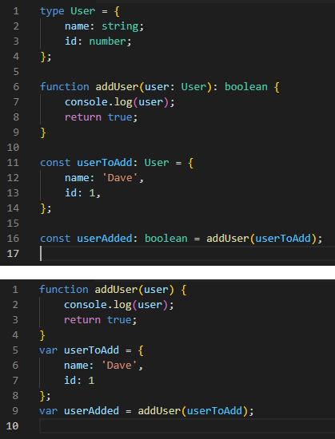
Compilation & Configuration
TypeScript code uses JavaScript compiler
Code gets compiled to JavaScript
Command to compile ts file
> tsc my-file.ts
TypeScript configuration related to compilation and other setting is stored in tsconfig.json file.
Below command can be used to create the config file
> tsc --init //creates tsconfig.json file

Slide 5
Hands on – Exercise-1:
Create a hello-world.ts file to alert ‘Hello World!’
Access the below link to see the example code
https://github.com/Prem119/typescript-workshop

Slide 6
TypeScript Fundamentals – Data Types
All supported JavaScript types are supported and has its own types like unknown, any, void and never
TypeScript types introduce strong type checking
Data type ‘any’ can be used specify any type

Slide 7
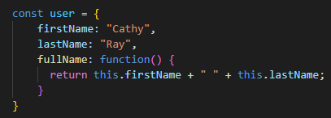
TypeScript Fundamentals – Primitive Types
Number, string, boolean, bigint, symbol, undefined, and null
Null and undefined can be assigned to other type like a string
Symbol() can be used to get a new unique symbol each time
TypeScript Objects - Everything else is an object type
It is a collection of key-value pairs

Slide 8
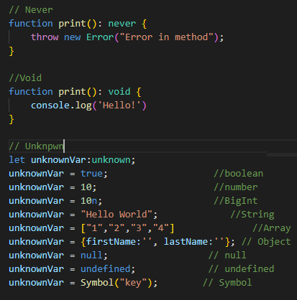
TypeScript Fundamentals – Special Types
Typescript has three other special types. They are never, void & unknown types
Never – This type will never return a value
Void – No return value
Unknown
The variable type is unknown.
Can assign anything to unknown type.
Cannot assign unknown to any other types

Slide 9
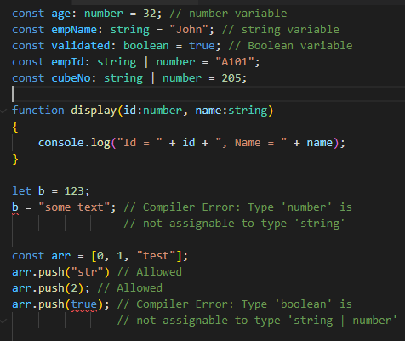
TypeScript Fundamentals – Type Annotation, Inference & Assertion
Typescript uses type annotation to specify the data type of the variable, function and its return value.
Syntax is :[type] – Here type is TypeScript data type
Union Types – Variable can have two or more type.
Compiler throws an error when different type is used
Anonymous objects – A TypeScript object with properties annotated
Type Inference
Type Assertion
as keyword // let employeeCode = code as number;
typeof(employeeCode)

Slide 10
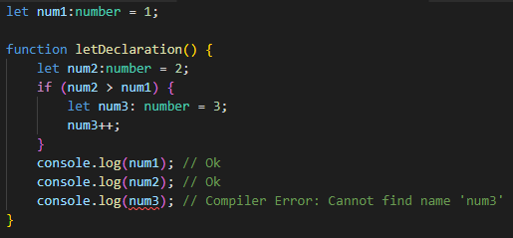
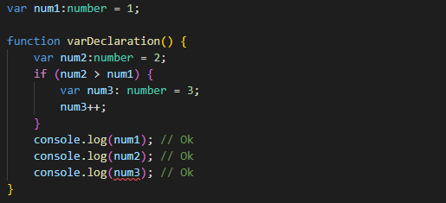
TypeScript Fundamentals – Variable
Variables are case-sensitive
Variables can be declared as const, let or var keyword
Const and let is block scoped
Var is function scoped
Let variables cannot be re-declared
Variables can be declared
Only with type
Only with value
Both type and value
Without type and value

Slide 11
Hands on – Exercise-2:
Fix the errors shown by the compiler
Access the below link to get the code
https://github.com/Prem119/typescript-workshop/blob/main/src/fix-the-errors.ts

Slide 12
ES6 New Feature Fundamentals
ECMAScript (ES) is a standardized scripting language
ES6 had a significant improvement to JS with below features
Let & const
For..of
Default parameters
REST operator
Spread operator
Destructuring
Template literals/strings
Arrow Functions
Promises
Classes

Slide 13

ES6 New Feature Fundamentals – For..of
for...of is an alternative for both for...in and forEach() and loops iterable data structures like Arrays, Maps, Sets, and Strings

Slide 14
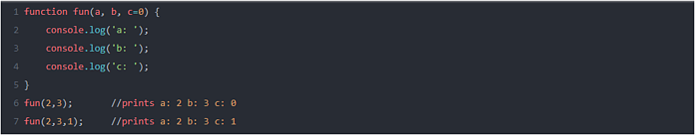
ES6 New Feature Fundamentals – Default Parameters
Provides default values to function parameters if no value or undefined is passed

Slide 15

ES6 New Feature Fundamentals - Rest Operator
It is used to handle function parameters. It uses three dots as its syntax (i.e …)

Slide 16

ES6 New Feature Fundamentals – Spread Operator
Spread Operator is used with arrays and its syntax is exactly the same as that of Rest Operator (ie …). It is used to split the contents of an array

Slide 17
ES6 New Feature Fundamentals – Destructuring
Destructuring helps in unpacking values from an array or an object

Slide 18

ES6 New Feature Fundamentals – Template Literals/Strings
It allows embedded expressions, which makes print statements easy

Slide 19
ES6 New Feature Fundamentals – Arrow Functions
Arrow Functions use => as its token and so are also called as Fat Arrow Functions
They are one-line functions and are much like Lambda functions in other programming languages. Prior to =>, JS has a function keyword

Slide 20
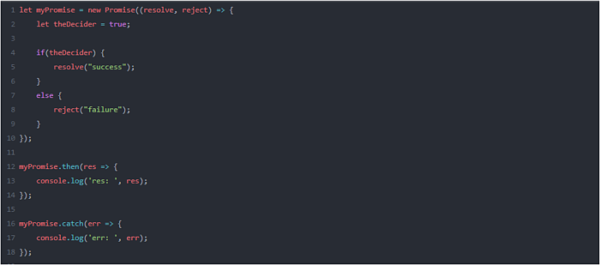
ES6 New Feature Fundamentals – Promises
Promises are introduced in ES6 to handle Asynchronous Programming in a more elegant way.
Before Promises, async calls were handled by Callbacks.

Slide 21
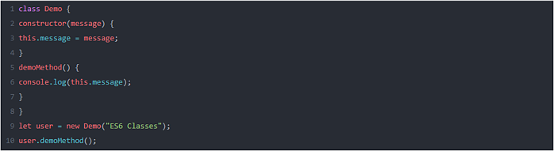
ES6 New Feature Fundamentals – Classes
The Objects in JavaScript are based on Prototypes and follows Prototypal Inheritance. But in ES6 the keyword class is introduced that makes the approach very easy.

Slide 22
Statements & Loops
if… else
switch case
for loop
while

Slide 23
Hands on – Exercise-3:
TBA
Access the below link to get the code
https://github.com/Prem119/typescript-workshop/blob/main/README.md
TypeScript Playground:
https://www.typescriptlang.org/play

Slide 24
References
https://www.typescriptlang.org/docs/
https://www.greycampus.com/blog/programming/java-script-versions

Slide 25
Q & A

